Slide 1


Stroke Validation Focused Study
VHA EPRP
FY2018

Slide 2
Study Purpose
Validate data elements for three electronic Stroke measures:
STK2 – Discharged on Antithrombotic Therapy
STK3 – Anticoagulation Therapy on Discharge for Atrial Fibrillation/Flutter
STK6 Discharged on Statin Therapy

Slide 3
Data Elements
Various familiar data elements
admdt
dcdate
princode
dcdispo
cmo (comfort)
clntrial
ldlc
statindc
nostatin
dcanthrm
ynoanthrm
anticoag
nocoag

Slide 4
Data Elements
New data elements to validate prepopulated data supplied by VHA
New data elements to validate location of data elements in record

Slide 5
IMPORTANT
For ANY review/focused study:
The VHA regards us as abstraction experts
Please read the questions carefully, review all
appropriate data sources, and enter data accurately
The abstracted data will be compared with the data captured electronically
Measures will be scored based on abstracted data
DACs and Exit Reports - no formal Exit Conference

Slide 6
REVIEW OF QUESTIONS
Q1 admdt - Prepopulated - can be modified
Q2 dcdate - Prepopulated - Cannot be modified
Q3 princode - Prepopulated - Cannot be modified

Slide 7
Q4 vprincode - Validation question
Is the diagnosis of ischemic stroke confirmed by physician documentation?
Yes
No - if No, case is excluded
If the physician documents a diagnosis of ischemic stroke in the discharge summary or elsewhere in the medical record and ischemic stroke is coded as the principal diagnosis, the diagnosis would be confirmed. Select “Yes”. D/D Rules have other terms for ischemic stroke.
If documentation clearly indicates the stroke was a hemorrhagic stroke, select “No”. D/D Rules have other terms for hemorrhagic stroke.

Slide 8
Q5 dcdispo - Prepopulated - cannot be Modified
Q6 dcdispom - Validation question
Does the prepopulated discharge disposition (computer to display dcdispo value and description) match the discharge disposition documented in the medical record?
Yes
No
If yes, will go to vdcdispo to validate the location(s) of the discharge disposition documentation.
If no, will go to dcdispo2 and enter the discharge disposition documented in the medical record. (This is same question as in all inpatient instruments.)

Slide 9
Q7 dcdispo2
If you answered “no” to DCDISPOM (prepopulated dc disposition did not match what you found in record) you will answer this question:
Enter the patient’s discharge disposition on the day of discharge documented in the medical record.
Same question as in all inpatient instruments.

Slide 10
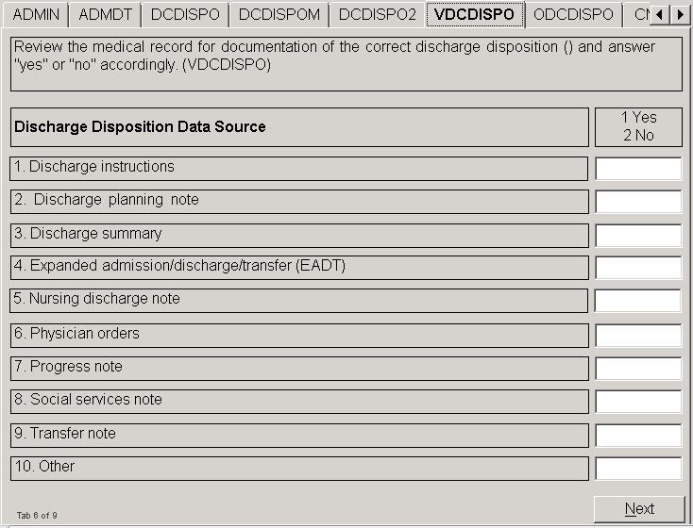
Q8 VDCDISPO - Validation Question
1

Slide 11
Q9 odcdispo
If you answered “yes” to #10. Other in VDCDISPO, you will answer this question:
Enter the name of the other discharge disposition data source.

Slide 12
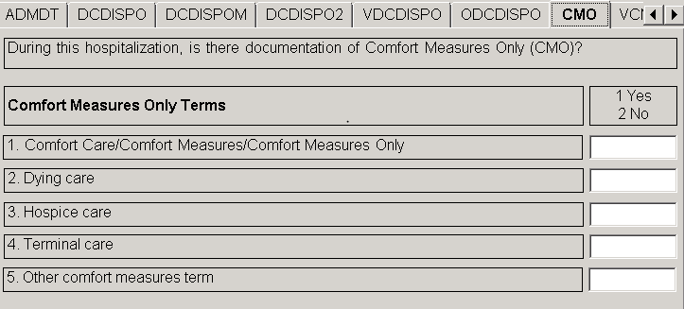
Q10 cmo
During this hospitalization, is there documentation of Comfort Measures Only? (Similar to comfort question in other instruments.)
Review the medical record for documentation of each comfort measures only term and answer “yes” or “no” accordingly.

Slide 13
Q11 ocmo
If you answered “yes” to #5. Other in CMO, you will answer this question:
Enter the other Comfort Measures Only term documented in the medical record.

Slide 14
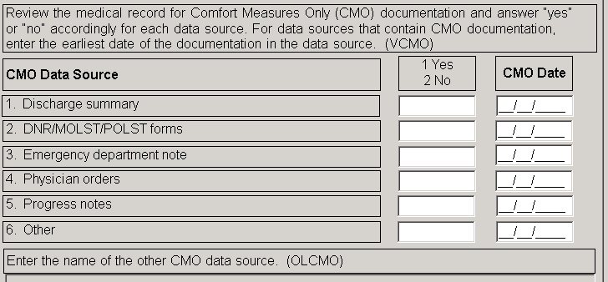
Q12 vcmo & q13 dtcmo - Validation Questions
Review the medical record for Comfort Measures Only (CMO) documentation and answer “yes” or “no” accordingly for each data source. For data sources that contain CMO documentation, enter the earliest date of the documentation in the data source.

Slide 15
Q14 olcmo & q15 clntrial
Q14 OLCMO
If you entered yes for #6 Other in VCMO, you will answer this question:
Enter the name of the other CMO data source.
Q15 CLNTRIAL (familiar question)
During this hospital stay, was the patient enrolled in a clinical trial in which patients with stroke were being studied?
Yes
No

Slide 16
Ldl-c Questions
The next 3 questions relate to LDL-c:
Q16 LDLC - Prepopulated “yes” or “no”
Is there medical record documentation of a LDL-c less than 70 mg/dL within 30 days prior to hospital admission or during hospitalization?
Q17 LDLCM - Same question answered by abstractor
Q18 VLDLC - Validation question
Review the medical record for documentation of a LDL-c less than 70mg/dL within 30 days prior to hospital admission or during the hospitalization and answer “yes” or “no” accordingly for each data source.

Slide 17
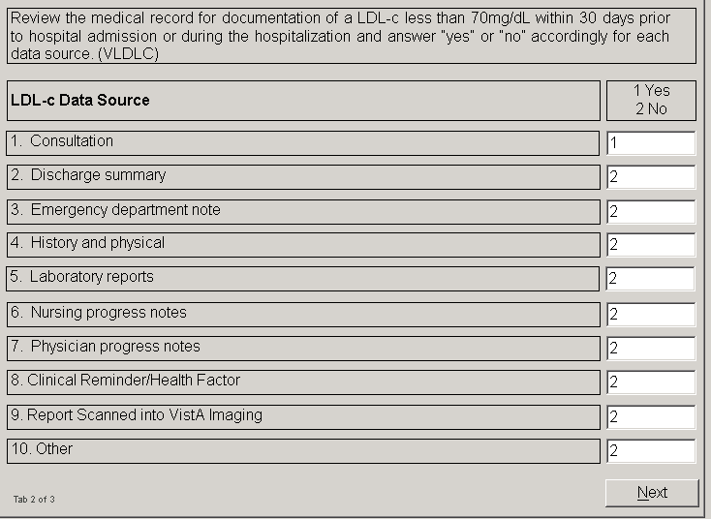
Q18 vldlc - Validation Question

Slide 18
Q19 olldlc
If you entered yes for #10. Other in VLDLC you will answer this question:
Enter the name of the other LDL-c data source.
Hopefully you are seeing a pattern to the questions!

Slide 19
Q20 through q48
Questions 20 through 48 relate to the following medications:
statins
antithrombotics
anticoagulants
For each category of medications you will have a similar set of questions. Let’s follow the statin medication questions first.

Slide 20
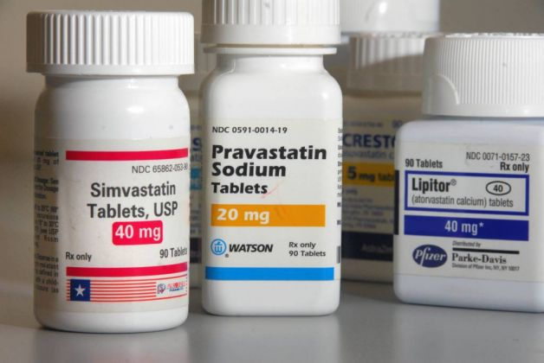
Statin medications

Slide 21
Statin medications
Q20 STATINDC2 - Prepopulated “yes” or “no”
Was a statin medication prescribed at discharge?
Q21 VSTATINDC - Basically same question answered by abstractor.
Is there documentation in the medical record that a statin medication was prescribed at discharge? Yes or No (Examples listed.) If No, will go to nostatin2.
Q22 STATNAME
Select the name of the statin medication prescribed at discharge.

Slide 22
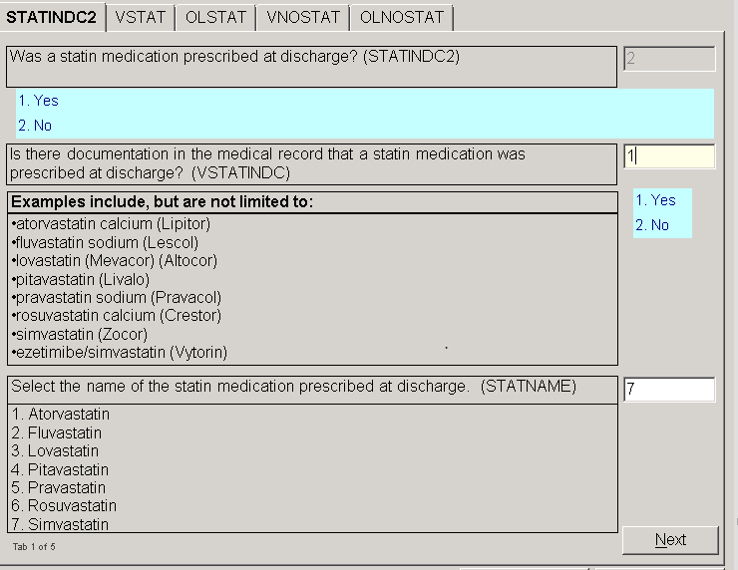

Slide 23
Q23 vstat & Q24 dtstat
Review each data source for documentation that a statin medication was prescribed at discharge and answer “yes” or “no” accordingly.
The computer will flag the data source and prepopulate the date for each data source 1 – 5 as applicable based on data from the Pull List.
For prepopulated date fields, the abstractor will review the data source for documentation that a statin medication was prescribed and answer “yes” or “no.”
For date fields that are not prepopulated, the abstractor will review the data source for documentation that a statin medication was prescribed, answer “yes” or “no” and enter the date of the documentation.

Slide 24
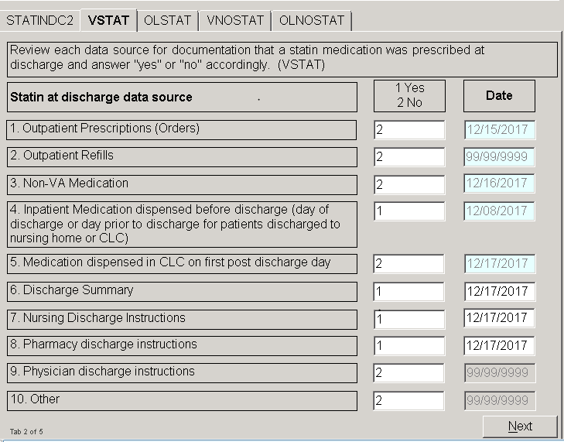

Slide 25
Q25 olstat
If you entered “Yes” for value 10 in VSTAT, you will answer this question:
Enter the other location where documentation of prescription of statin medication at discharge was found in the medical record.
Progress Note

Slide 26
Q26 nostatin2
If there was no documentation of a statin prescribed (vstatindc = 2), you will answer a somewhat familiar question:
Is there physician/APN/PA or pharmacist documentation of a reason for not prescribing a statin medication at discharge?
Allergy to statin medication
Physician/APN/PA or pharmacist documentation of a reason for not prescribing a statin medication at discharge
95. Not applicable
98. Patient/family refusal
99. No documented reason
Use your D/D rules to determine if there is documentation of a reason for not prescribing statin therapy at discharge.

Slide 27
Q27 vnostat
If there was a documented reason for not prescribing a statin medication at discharge then you will answer the validation question:
Review each data source for documentation of a reason for not prescribing statin therapy at discharge and answer “yes” or “no” accordingly.
In order to answer this question accurately, it is necessary to review ALL relevant data sources for documentation of a reason for not prescribing a statin medication at discharge.

Slide 28
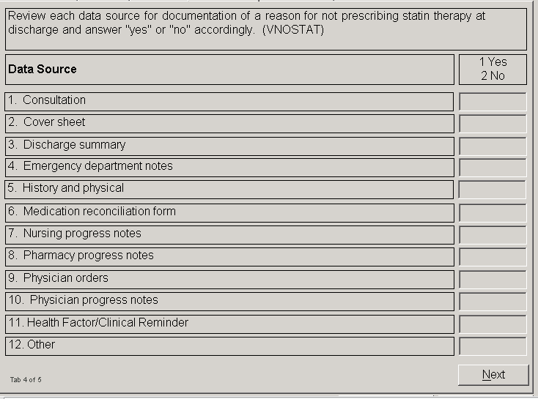

Slide 29
Q28 olnostat
If you entered “yes” for value 12 in VNOSTAT, you will answer:
Enter the other location where documentation of a reason for not prescribing statin therapy at discharge was found in the medical record.

Slide 30
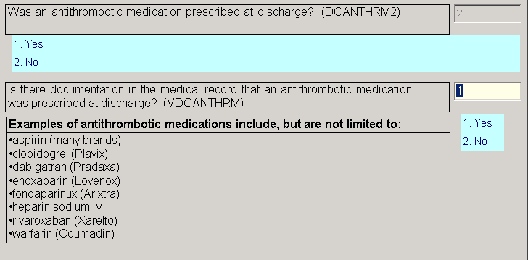
ANTITHROMBOTIC MEDICATIONS
The questions for this category of medications follow the same pattern as the statin medication questions.
Q29 DCANTHRM2 - Prepopulated “yes” or “no” -
Q30 VDCANTHRM - Abstractor validates “yes” or “no”

Slide 31
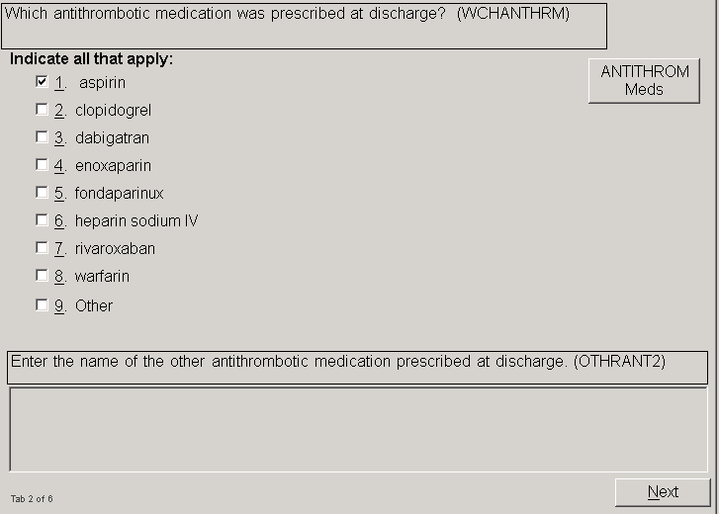
Q31 wchanthrm

Slide 32
Special notes
You notice in WCHANTHRM it says:
Indicate all that apply:
This list of medications is not all inclusive.
If options are auto-filled, please review carefully to determine if other antithrombotic medications were prescribed at discharge.
Some medications used for antithrombotic therapy are also used for anticoagulant therapy.

Slide 33
ANTITHROMBOTIC MEDICATIONS
Q32 othrant2 - If the antithrombotic medication was not one listed in wchanthrm, you will enter the name of the other antithrombotic medication prescribed at discharge.
Q33 vanth and Q34 dtanth - questions to validate the location and date of documentation that an antithrombotic was prescribed at discharge.

Slide 34
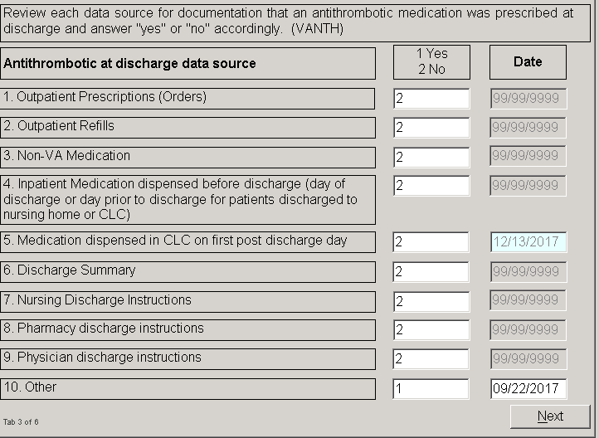
Q33 vanth & q34 dtanth

Slide 35
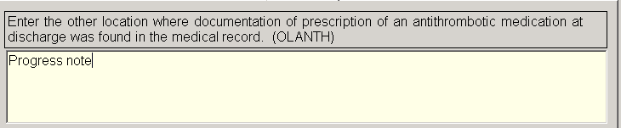
Q35 olanth
If you entered “yes” for value 10 in VANTH, you will answer:

Slide 36
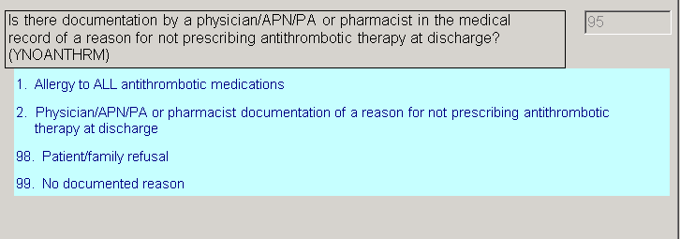
Q36 ynoanthrm
If there was no documentation that an antithrombotic was prescribed at discharge you will answer this question:
In this case, it was auto-filled as 95 because VDCANTHRM (Is there documentation in the medical record that an antithrombotic medication was prescribed at discharge?) was answered yes.

Slide 37
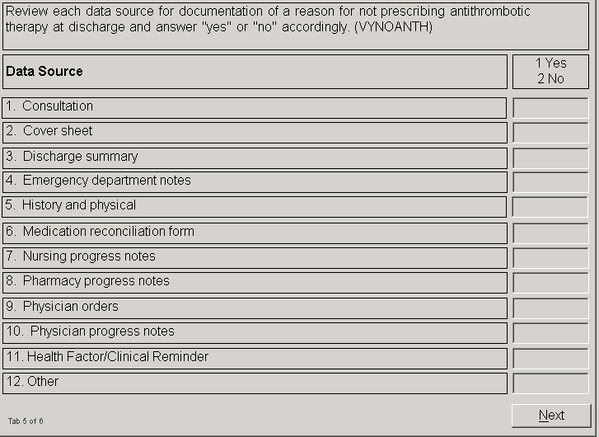
Q36 vynoanthrm
Validation question for location of documentation of reason for not prescribing antithrombotic at discharge

Slide 38

Q38 othrsnloc
If you entered “yes” for value 12 in VYNOANTH, you will answer:
Enter the other location where documentation of a reason for not prescribing antithrombotic therapy at discharge was found in the medical record.

Slide 39
Anticoagulant medications
Questions 39 - 48 similar to the questions on antithrombotics, but are related to anticoagulant medications prescribed at discharge
Q39 anticoag - Prepopulated “yes” or “no”
Q40 vanticoag - Abstractor validates “yes” or “no”
Q41 wchcoag - Which anticoagulant medication

Slide 40
Special notes
Q41 WCHCOAG
Which anticoagulant medication was prescribed at discharge? Indicate all that apply:
This list of medications is not all inclusive.
If options are auto-filled, please review carefully to determine if other anticoagulant medications were prescribed at discharge.
Some medications used for anticoagulant therapy are also used for antithrombotic therapy.

Slide 41
Anticoagulant medications
Q42 othcoag - If the anticoagulant medication was not one listed in wchcoag, you will enter the name of the other anticoagulant medication prescribed at discharge.
Q43 vcoag and Q44 dtcoag - questions to validate the location and date of documentation that an anticoagulant was prescribed at discharge.

Slide 42
Q45 olcoag - question to enter the other location where documentation of prescription of an anticoagulant medication at discharge was found in the medical record.
Q46 nocoag - documentation of a reason for not prescribing anticoagulant at discharge.
Q47 vnocoag - validation question for location of documentation of reason for not prescribing anticoagulant at discharge
Q48 olnocoag - question to enter the other location where documentation of a reason for not prescribing anticoagulant at discharge was found

Slide 43
scoring
Stroke Measures:
STK2 – Discharged on Antithrombotic Therapy
STK3 – Anticoagulation Therapy on Discharge for Atrial Fibrillation/Flutter
STK6 Discharged on Statin Medication
Scoring for all 3 measures based on abstracted data

Slide 44
Scoring
Exclusions common to all 3 measures:
Acute-care admission is elective
Date of discharge is <11/01/17 or after 11/30/17
Length of stay is >120 days
Patient age <18
Principal Diagnosis Code (ICD-10-CM) is not Ischemic Stroke
Discharge disposition:
* to another hospital
* left AMA
* expired
* to home for hospice care
* to health care facility for hospice care
Documentation of comfort measures only any time during the hospital stay
Enrolled in a clinical trial in which patients with stroke are being studied during the hospital stay

Slide 45
scoring
STK2 - Discharged on Antithrombotic Therapy
Specific Exclusion:
Documented reason for not prescribing antithrombotic therapy at discharge
Case passes if:
Antithrombotic therapy was prescribed at discharge

Slide 46
scoring
STK3 - Anticoagulation Therapy on Discharge for Atrial Fibrillation/Flutter
Specific Exclusions:
No Diagnosis Code of atrial fibrillation/flutter
Documented reason for not prescribing anticoagulation therapy at discharge
Case passes if:
Anticoagulation therapy was prescribed at discharge

Slide 47
scoring
STK6 Discharged on Statin Medication
Specific Exclusions:
LDL-c of <70mg/dL <30 days prior to arrival or any time during the hospital stay
Documented reason for not prescribing statin medication at discharge
Case passes if:
Statin medication was prescribed at discharge

Slide 48
conclusion
Anticipate the Pull list to be released February 1, 2018
Complete abstraction by February 28, 2018
Please send any questions to;
Sharon Miller (shmiller@qualityinsights.org) or
Anna Sites (asites@qualityinsights.org)

