Slide 1


The healthcare improvement experts.
Sepsis Study FY2020
VHA EPRP V
Sharon Miller
VHA EPRP QIC

Slide 2
Study Purpose
VHA Office of Reporting, Analytics, Performance, Improvement and Deployment (RAPID) will begin collecting and reporting the SEP-1 measure for CMS.
This will be a Pilot Study.
DACs and Exits will be required for facility information
NO formal Exit conference required

Slide 3
SEP-1 Measure: Early Management Bundle, Severe Sepsis/Septic Shock
Composite measure that includes a bundle of interventions intended to effectively treat severe sepsis and septic shock
Focuses on adults 18 years and older with a diagnosis of severe sepsis or septic shock
Assesses:
  measurement of lactate
  obtaining blood cultures
  administering broad spectrum antibiotics
  fluid resuscitation
  vasopressor administration
  reassessment of volume status and tissue perfusion
  repeat lactate measurement
First three interventions should occur within 3 hours of presentation of severe sepsis; fourth within 3 hours of septic shock; next two within 6 hours of presentation of septic shock; last intervention within 6 hours of severe sepsis.

Slide 4
SEP-1
Numerator: patients who received ALL of the following: Within three hours of presentation of severe sepsis:
Initial lactate level
Broad spectrum or other antibiotics administered
Blood cultures drawn prior to antibiotics
AND received within six hours of presentation of severe sepsis, ONLY if the initial lactate is elevated
Repeat lactate level measurement

Slide 5
SEP-1 (cont.)
AND within three hours of initial hypotension OR septic shock
Resuscitation with 30 mL/kg crystalloid fluids
AND within six hours of septic shock presentation, ONLY if hypotension persists after fluid administration:
Vasopressors are administered
AND within six hours of septic shock presentation, if hypotension persists after fluid administration or initial lactate >= 4 mmol/L
Repeat volume status and tissue perfusion assessment is performed

Slide 6
SEP-1 (cont.)
Denominator: Inpatients age 18 and over with an ICD-10-CM Principal or Other Diagnosis Code of Sepsis, Severe Sepsis or Septic Shock as defined in Appendix A, Table 4.01
Excluded Populations:
  Comfort Care or Palliative Care within 6 hours of severe sepsis OR septic shock presentation
  Contraindication to care within 6 hours of severe sepsis OR septic shock presentation
  LOS > 120 days
  Transfer in from another acute care facility
  Enrolled in clinical trial for sepsis, severe sepsis, septic shock
  Patients with severe sepsis OR septic shock discharged within 6 hours of presentation
  Patients receiving antibiotics for >24 hours prior to presentation

Slide 7
SEP-1 Sub-Measures
RAPID – currently electing to report 5 sub-measures
Sep1a
Denominator – All acute care inpatients with a diagnosis of Severe Sepsis
Numerator – Patients who received ALL the following within three hours of presentation of severe sepsis:
∗ Initial lactate level measurement
∗ Broad spectrum or other antibiotics administered
∗ Blood cultures drawn prior to antibiotics

Slide 8
Sub-Measures
Sep1b
Denominator – All acute care inpatients with a diagnosis of Severe Sepsis AND initial lactate is elevated.
Numerator – Patients who received a repeat lactate level within six hours of presentation of severe sepsis

Slide 9
Sub-Measures
Sep1c
Denominator – All acute care inpatients with a diagnosis of Severe Sepsis AND have hypotension – OR have a diagnosis of Septic Shock
Numerator – Patients who received resuscitation with 30 mL/kg crystalloid fluids within three hours of initial hypotension OR septic shock

Slide 10
Sub-Measures
Sep1d
Denominator – All acute care inpatients with septic shock AND hypotension that persists after fluid administration.
Numerator – Patients who receive vasopressors within six hours of septic shock presentation

Slide 11
Sub-Measures
Sep1e
Denominator – All acute care inpatients with septic shock AND hypotension that persists after fluid administration – OR initial lactate >= 4mmol/L
Numerator – Patients who have a repeat volume status AND tissue perfusion assessment performed within six hours of septic shock presentation

Slide 12
Data Collection Questions
Instrument has 54 questions
Most of first 11 should be familiar
Q1 arrvdate – Enter earliest date arrived in acute care
Q2 admdt – auto-filled, can be modified
Q3 trnsfr – Was patient received as transfer from
inpatient, outpatient, or ED/Observation dept.
of an OUTSIDE hospital or ambulatory surgery center
  lists of other specific types of transfers in D/D Rules acceptable for “Yes” or “No” answers
  Read carefully Acute Rehab and Psych “Unit” vs
“Hospital” and INSIDE vs OUTSIDE your hospital
  “Yes” answer excludes the case

Slide 13
Data Collection Questions (cont.)
Q4 dcdt - autofilled; cannot be modified
Q5 dctm - autofilled; cannot be modified
Q6 princode – autofilled with ability to change
Q7 othrcode1-24 – autofilled; cannot be modified
Q8 prinpx/prinpxdt – principal procedure code/date
Q9 othrpx/othrpxdt1-5 – other procedure codes/dates
Q10 dcdispo
Q11 clntrial – if “Yes” case is excluded

Slide 14
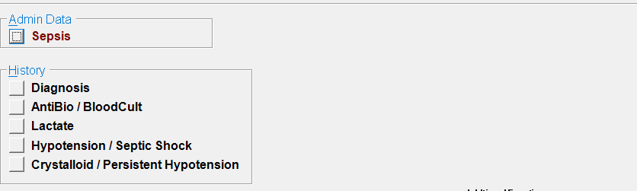
Order of Abstraction
Once the Admin Data is complete, you will need to complete Diagnosis module FIRST
All other modules depend on dates/times entered in Diagnosis module

Slide 15
Severe Sepsis Presentation
May be identified based upon physician/APN/PA documentation of severe sepsis or clinical criteria
In this Pilot Study, will be looking for both
Will first look for documentation of severe sepsis
  Must say “severe sepsis”

Slide 16
Q12 seppres
Did a physician/APN/PA document presence of severe sepsis?
If no physician/APN/PA documentation of severe sepsis, but there is documentation of septic shock, select Value “1” (Yes).
Other Documentation Acceptable to Select Value “1”
Documentation of severe sepsis within an order set, etc. IF: recorded date and time is present and is earliest date and time recorded
May use pre-hospital records (EMS, SNF) if found in CPRS/CAPRI/JLV
If more than one presentation of severe sepsis, use only first

Slide 17
Q12 seppres
Documentation to Select Value “2” (No).
Title or heading of order set, protocol, checklist, etc.
Severe sepsis documented as due to viral, fungal, or parasitic infection
Severe sepsis documented in discharge note, DC summary, or note after time of discharge
if within 6 hours after severe sepsis documentation, physician/APN/PA notes indicate patient:
  is not septic
  does not have sepsis or severe sepsis
  does not have septic shock and severe sepsis was met by physician/APN/PA documentation septic shock was present

Slide 18
Q12 seppres (cont.)
Severe sepsis documented using a qualifier
Qualifiers Table in D/D rules
Positive = Yes (e.g., Possible severe sepsis)
Negative OR Negative and Positive = No (e.g., Doubt severe sepsis; Questionable, but likely severe sepsis)
Exclude: Bacteremia, Septicemia
Data Sources: ONLY Physician/APN/PA documentation

Slide 19
Documentation Examples
Some facilities may have Templates
  ED
  ICU
ICUs may have own software vendors for documentation
May need to use JLV for scanned ICU notes

Slide 20
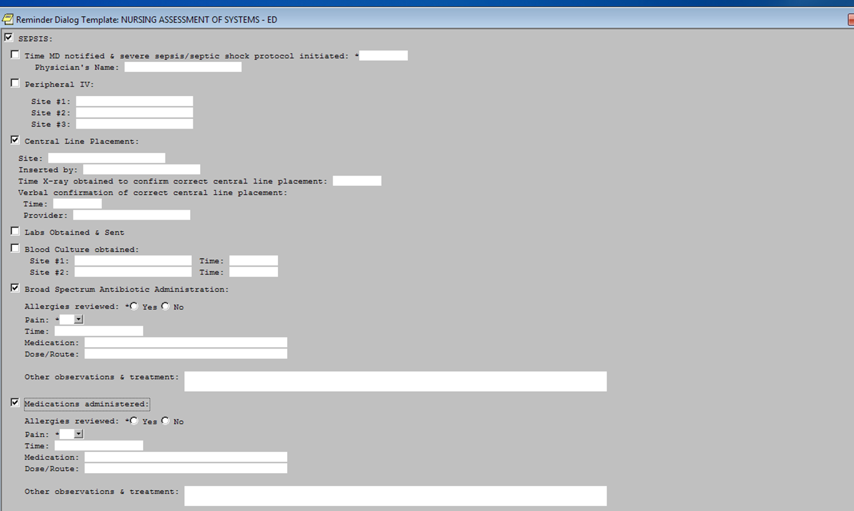
Sample ED Template

Slide 21
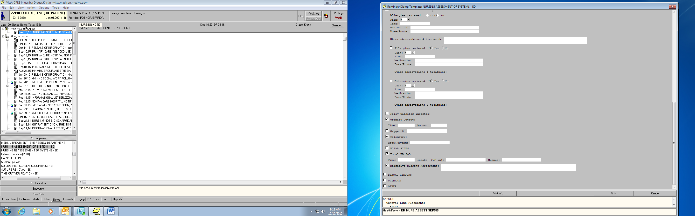

Slide 22
Q13 sepdt / septm
Use earliest date/time physician/APN/PA documented severe sepsis
If documented in note w/o specific date/time or using POA, the following apply:
  If it is only documentation, use date/time note started
  If documented multiple times in note, use earliest
Use earliest arrival date/time for ED patient with:
  Physician/APN/PA documentation in pre-hospital note
  Physician/APN/PA documentation severe sepsis present on
  arrival

Slide 23
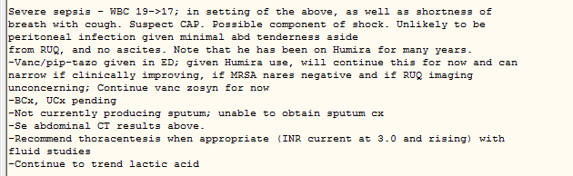
Q13 sepdt / septm
ED Clinician Note 3/30/2019 0250

Slide 24
Q13 sepdt / Q14 septm (cont.)
Use earliest arrival date/time on floor/unit for direct admits and there is:
  Physician/APN/PA documentation of severe sepsis in
  pre-hospital note and patient is direct admit
  Physician/APN/PA documentation severe sepsis present on
  admission
If only documentation of severe sepsis POA, use earliest date/time of:
  Physician/APN/PA note
  Admit order
  Disposition to inpatient
  Arrival to floor/unit

Slide 25
Q13 sepdt / Q14 septm (cont.)
If no documentation of severe sepsis, but there is physician/APN/PA documentation of septic shock, enter earliest date/time septic shock documented

Slide 26
Severe Sepsis Clinical Criteria
Intent of next set of questions is to determine if/when clinical criteria for severe sepsis were met.
In order to establish the presence of severe sepsis by clinical criteria, all three clinical criteria
  documentation of infection,
  two or more manifestations of systemic infection, and
  organ dysfunction
must be met within 6 hours of each other. The three
clinical criteria do not need to be documented in any
particular order.

Slide 27
Clinical Criteria – (1)Documentation of Infection
Q15 sepinf – Is there documentation of infection in the medical record?
Table of conditions commonly associated with severe sepsis – NOT all inclusive
Acceptable Documentation of Infection
Physician/APN/PA or nursing documentation referencing presence of infection
Antibiotic is ordered for inflammatory condition or sign/symptom of infection - may be considered documentation of infection (e.g., ceftriaxone ordered for colitis, Zosyn 3.375 g IV q6hr for cough).

Slide 28
Q15 sepinf
Exclusions: Documentation NOT acceptable for an infection:
If within 6 hours following initial documentation, there is additional physician/APN/PA documentation indicating infection is not present, disregard the initial documentation.
  Example: ED physician/APN/PA documents rule out UTI and pneumonia at 0500. At 1000 hospitalist documents no infection present. Disregard ED physician/APN/PA documentation of rule out UTI and pneumonia

Slide 29
Q15 sepinf (cont.)
Exclusions (cont.):
Colonization, positive screens, or positive cultures (e.g., MRSA, VRE) without physician/APN/PA documentation referencing infection
Fungal, parasitic or viral infections
History of infection, recent infection or recurrent infection not documented as current or active infection
Orders for tests, results of tests, signs/symptoms of infection without supportive documentation of infection

Slide 30
Q15 sepinf (cont.)
Documentation of Infection using Qualifiers
Same table of Positive/Negative Qualifiers as in severe sepsis
  Positive qualifier should be used to meet criteria
  Negative qualifier or both negative/positive qualifiers should NOT be used

Slide 31
Q16 infdt and inftm
Use earliest date/time physician/APN/PA or nursing documentation of presence of infection
ED Patients: Use earliest documented arrival date/time for patients who enter ED with documentation of infection in pre-hospital records or present on arrival (POA).
Direct Admit Patients: Use earliest documented date/time patient arrives to the floor or unit with documentation of infection in pre-hospital records or POA.
If the only documentation of infection being present is in a physician/APN/PA or nursing note that infection was present on admission (POA), use the earliest date/time the following note type was started or opened:
  Physician/APN/PA or nursing note
  Admit order
  Disposition to inpatient
  Arrival to floor or unit

Slide 32
Clinical Criteria (2) Q17 sepsirs
Is there documentation in the medical record of two (2) or more of the following manifestations(indications) of systemic infection:
Indicate all that apply:
1. Temperature >38.3 C or <36.0 C (>100.9 F or < 96.8 F)
2. Heart rate (pulse) >90
3. Respiration >20 per minute
4. White blood cell count >12,000 or <4,000 or >10% bands
99. None of the above documented

Slide 33
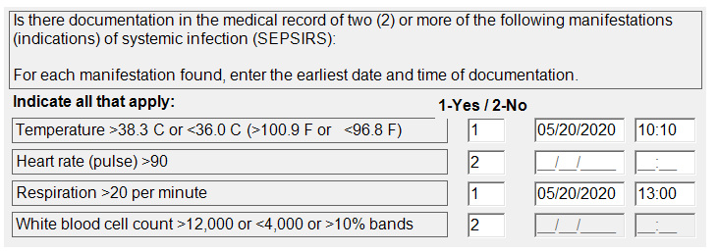
Q17 sepsirs

Slide 34
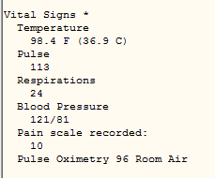
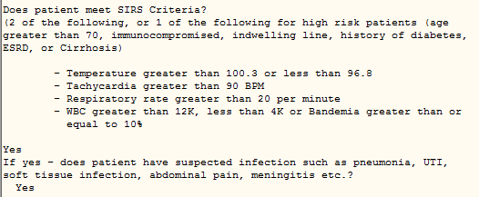
Sample Documentation

Slide 35
Clinical Criteria (3) Q18 seporg
Is there documentation of organ dysfunction in the medical record?
Indicate all that apply:
1. Systolic blood pressure (SBP) < 90 mmHg or mean arterial pressure < 65 mmHg
2. Systolic blood pressure (SBP) decrease of more than 40 mmHg (see definitions/decision (D/D) rules)
3. Acute respiratory failure as evidenced by a new need for invasive or non-invasive mechanical ventilation (see D/D rules)
4. Creatinine > 2.0 (see D/D rules)
5. Urine output < 0.5mL//kg/hour for 2 consecutive hours (see D/D rules)
6. Total bilirubin > 2 mg/dL (34.2 mmol/L)
7. Platelet count < 100,000
8. INR > 1.5 or aPTT > 60 seconds (see D/D rules)
9. Lactate > 18.0 mg/dL (>2 mmol/L)

Slide 36
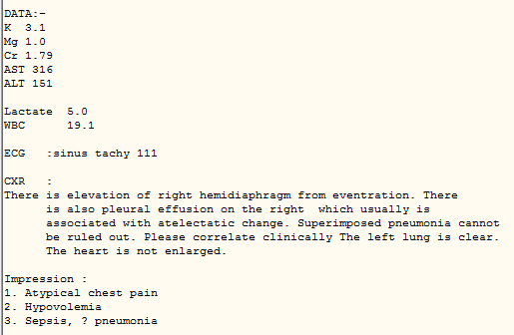
Sample Documentation

Slide 37
Q18 seporg
Organ dysfunction, evidenced by any one of question options
Hypotension – SBP < 90 mmHg or MAP < 65 mmHg
SBP ↓ > 40 mmHg – physician/APN/PA documentation the ↓ is related to infection, severe sepsis, septic shock NOT other causes
Acute respiratory failure
- intubated/tracheostomy on ventilator
- BiPAP/CPAP
- New need for invasive/non-invasive mechanical
ventilation

Slide 38
Q18 seporg
Creatinine > 2.0 – physician/APN/PA documentation of ESRD and dialysis prior to or within 24 hours following presentation of severe sepsis – disregard reported creatinine levels as signs of organ dysfunction
Urine output <0.5 mL/hr (for 2 hours) – clear documentation urine is being monitored hourly
INR > 1.5 or aPTT > 60 sec – if given anticoagulant in Appendix C Table 5.3, do NOT use elevated levels; Heparin flushes do not count.

Slide 39
Q18 seporgdt/seporgtm
For each of those options found, enter the earliest date/time of documentation
In software, question will look like sepsirs on a previous slide

Slide 40
Q19 sepsisdt and sepsistm
Question will be auto-filled based on responses to severe sepsis clinical criteria questions, dates and times.
If all 3 clinical criteria are met within 6 hours of each other, will be autofilled with most recent date/time from infdt/tm, sepsirsdt/tm and seporgdt/tm

Slide 41
Q19 sepsisdt and sepsistm (cont.)
If there is documentation of severe sepsis and not all clinical criteria are met within 6 hours of each other, will be auto-filled with 99’s and will go to cntrasevsep.
If NO documentation of severe sepsis or severe sepsis not met by all three clinical criteria within 6 hours of each other, abstraction will stop here.

Slide 42
Q20 sepresdt and Q21 seprestm
This date and time will be auto-filled with the earliest valid date/time entered for documentation of severe sepsis (sepdt/septm) or the most recent date/time from documentation of when the final clinical criterion for severe sepsis was met (sepsisdt/sepsistm).

Slide 43
Q22 cntrasevsep
During the timeframe from 6 hours before severe sepsis presentation date and time to 6 hours after severe sepsis presentation date and time is there physician/APN/PA or nursing documentation that the patient or authorized patient advocate refused either a blood draw, IV fluid administration, or IV antibiotic administration?
ACCEPTABLE:
Specific documentation patient/authorized advocate refused blood draws, IV/IO fluids, IV/IO antibiotics
General documentation of refusal of care/ noncompliance
Left AMA in timeframe (signed form not required)
  Do not consider any AMA documentation as “contradictory”

Slide 44
Q22 contrasevsep
NOT ACCEPTABLE:
Refusal of specific blood draws not impacting requirements of measure (e.g. HIV, ABG)
Documentation patient left before DC instructions could be given does not count as leaving AMA
Inclusions: Declined; Does not want; Refused; Requests not to be given
A “yes” answer will exclude case.

Slide 45
Q23 cmopall
During the timeframe from 6 hours before severe sepsis presentation date and time to 6 hours after severe sepsis presentation date and time is there physician/APN/PA documentation of comfort measures only or palliative care?
Only accept terms identified in the list of inclusions. No other terminology will be accepted
Other guidelines essentially same as COMFORT in other instruments (See D/D rules)
A “yes” answer AND other conditions will exclude case.

Slide 46
Q24 antibio
During the timeframe from (24 hours prior or 3 hours after severe sepsis presentation date/time) was a broad spectrum or other antibiotic administered intravenously (IV)?
Only IV antibiotics administered in 24 hours prior to or 3 hours after severe sepsis presentation are acceptable.
For informational purposes antibiotics administered up to 6 hours after Severe Sepsis Presentation Date/Time are being collected.
EXCEPTION: If documentation indicates IV access could not
be established, antibiotics via intramuscular (IM) or
intraosseous (IO) started in timeframe are acceptable

Slide 47
Q24 antibio
ONLY ACCEPT:
Documentation demonstrating actual administration (antibiotic name, route, date, time)
Pre-hospital records may be used
NOT ACCEPTABLE:
Order without marked as “started” with date/time
Test doses
Documentation in sources that do not represent actual administration
Documentation in narrative note unless no other documentation
Documentation without all components (name, route, date, time)

Slide 48
Q25 bioname / biodate / biotime
Beginning with first antibiotic administered, enter name, date and time of administration for each antibiotic given intravenously (IV).
For informational purposes dates/times up to 6 hours after severe sepsis date/time are being collected
Only IV antibiotic(s) administered 24 hours prior to or 3 hours after severe sepsis presentation are acceptable.
  EXCEPTION: If documentation indicates IV access could not be established, antibiotics via intramuscular (IM) or intraosseous (IO) in timeframe are acceptable.
Other guidelines same as antibio

Slide 49
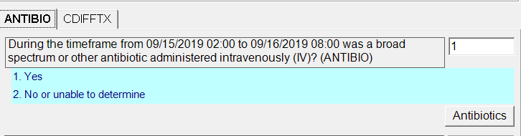
Q24 antibio
Entering “1” – will enable Antibiotics tab

Slide 50
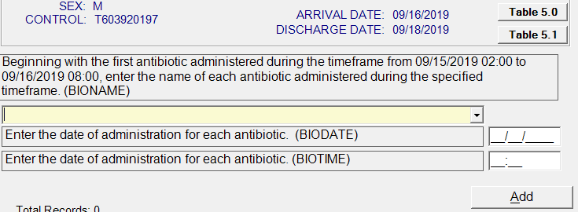
Q25 bioname / biodate / biotime
Antibiotic
Tables
Drop Down
Menu for antibiotics
Timeframe – 24 hours before severe sepsis date/time to 3 hours after

Slide 51
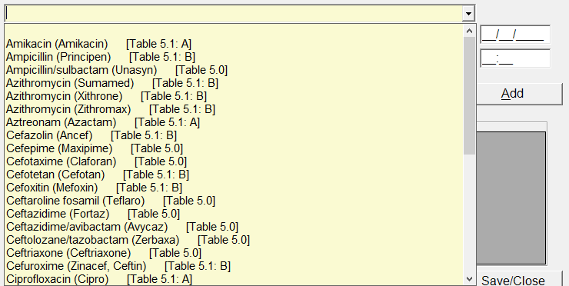
Q25 bioname / biodate / biotime
Enter earliest date/time for each
Scroll to find antibiotic

Slide 52
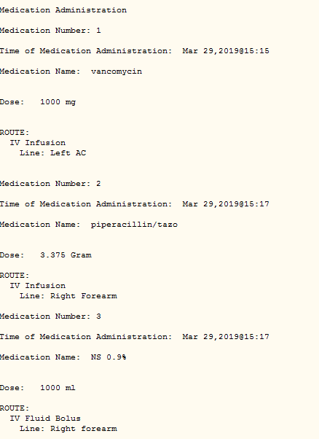
Sample Documentation

Slide 53
Q26 antisel
Intent is to determine if antibiotic (bioname) given is consistent with antibiotic selection guidelines and given within 3 hours after severe sepsis date and time.
Guidelines based on “Monotherapy” (Table 5.0)or “Combination Therapy” (Table 5.1) Tables
Will be auto-filled as “1” if one antibiotic is on Table 5.0 and given in timeframe OR
If no antibiotic on Table 5.0, but one from Table 5.1, Column A AND one from Column B given in timeframe
Otherwise it will be auto-filled as “2”

Slide 54
TJC Appendix C Table 5.0
Generic | Brand
Moxifloxacin | Avelox
Ceftazidime/avibactam | Avycaz
Ceftriaxone | Ceftriaxone
Cefotaxime | Claforan
Doripenem | Doribax
Ceftazidime | Fortaz
Ertapenem | Invanz
Levofloxacin | Levaquin
Cefepime | Maxipime
Meropenem | Merrem
Imipenem/Cilastatin | Primaxin
Ceftaroline fosamil | Teflaro
Ampicillin/sulbactam | Unasyn
Ceftolozane/tazobactam | Zerbaxa
Piperacillin/tazobactam | Zosyn

Slide 55
TJC Appendix C Table 5.1
Table 5.1: Antibiotic Generic/Trade Name Crosswalk, Sepsis Antibiotic Selection Options
COLUMN A |  | COLUMN B
Generic Name | Trade Name | Generic Name | Trade Name
Aminoglycosides |  | Cephalosporins (1st and 2nd Generation)
Amikacin | Amikacin | Cefazolin | Ancef
Gentamicin | Gentak | Cefotetan | Cefotan
Kanamycin | Kanamycin | Cefuroxime | Zinacef, Ceftin
Tobramycin | Nebcin | Cefoxitin | Mefoxin
Aztreonam |  | Clindamycin IV
Aztreonam | Azactam | Clindamycin | Cleocin
Ciprofloxacin |  | Daptomycin
Ciprofloxacin | Cipro | Daptomycin | Cubicin
 |  | Glycopeptides
 |  | Teicoplanin | Targocid
 |  | Vancomycin | Vancocin
 |  | Telavancin | Vibativ
 |  | Linezolid
 |  | Linezolid | Zyvox
 |  | Macrolides
 |  | Erythromycin | Erythrocin
 |  | Azithromycin | Zithromax
 |  | Azithromycin | Xithrone
 |  | Azithromycin | Sumamed
 |  | Penicillins
 |  | Ampicillin | Principen
 |  | Nafcillin | Nafcil, Nallpen
 |  | Oxacillin | Bactocill
 |  | Penicillin G | Penicillin G

Slide 56
Q26 antisel
Example:
Severe Sepsis Presentation Time 1200
Ciprofloxacin initiated at 1230
Vancomycin initiated at 1330
Combination Antibiotic Therapy Table:
Ciprofloxacin is in column A
Vancomycin is in column B
Both antibiotics were initiated within 3 hours of severe sepsis presentation time, therefore value “1” would be auto-filled.
If appropriate antibiotics not given in timeframe OR no antibiotics in timeframe value “2” will be auto-filled and go to selcult

Slide 57
Q27 selcult
Is there Physician/APN/PA documentation referencing the results of a culture within 5 days prior to earliest antibiotic date/time?
If IV antibiotic(s) from Table 5.0 or appropriate combination of IV antibiotics from Table 5.1 are not started within 3 hours following presentation of severe sepsis, and the following conditions are met, choose value "1."
  There is Physician/APN/PA documentation referencing the results of a culture from within 5 days prior to the antibiotic start time. The documentation must:
    Identify the date of the culture results (must be within 5 days prior to the antibiotic start date/time).
    Identify the suspected causative organism from the culture result and its antibiotic susceptibility.

Slide 58
Q27 selcult
  The IV antibiotic(s) identified as appropriate per the physician/APN/PA documentation is started within 3 hours following the presentation of severe sepsis.
  Example: Acceptable physician/APN/PA
  documentation: “Urine culture results from
  9/10/19 show enterococcus, sensitive to
  vancomycin.” The patient has severe sepsis with
  criteria met on 9/15/19 at 15:00 and the only
  antibiotic started is IV vancomycin at 15:30.
If these two conditions are NOT met, select value “2” and go to cdiff

Slide 59
Q28 cdiff
During the timeframe within 24 hours prior to earliest date/time of antibiotic administration is there physician/APN/PA documentation identifying the presence of C. difficile?
If the patient has C. difficile, and IV antibiotic(s) from Table 5.0 or an appropriate combination of IV antibiotics from Table 5.1 are not started within the 3 hours following presentation of severe sepsis, and the following conditions are met, choose value "1."
  There is physician/APN/PA documentation within 24 hours prior to the antibiotic start time identifying the presence of C. difficile. Documentation that C. difficile is suspected or likely is acceptable.
If “yes”, go to cdifftx

Slide 60
Q29 cdifftx
During the timeframe 3 hours after severe sepsis presentation date/time is there documentation of any one of the following treatments.
Oral vancomycin with or without oral or IV metronidazole
(Flagyl)
Rectal vancomycin with or without IV metronidazole (Flagyl)
IV metronidazole (Flagyl) monotherapy

Slide 61
Q30 bloodcul
Two timeframes to consider for when blood culture drawn – intent is to determine if blood culture drawn before antibiotic given
If patient receives IV or IO antibiotic within 24 hours before presentation of severe sepsis, timeframe is:
  24 hours prior to antibiotic date/time through 3 hours after severe sepsis presentation date/time
If patient does not receive IV or IO antibiotic within 24 hours before presentation of severe sepsis, timeframe is:
  24 hours prior to severe sepsis presentation date/time through 3 hours after severe sepsis presentation date/time

Slide 62
Q30 bloodcul
Include:
Documentation blood cultures (BC), actually drawn/collected
BC ordered and attempted to collect, but attempt fails or specimen contaminated
Supportive documentation blood culture was collected in appropriate timeframe
Exclude:
Blood sent to lab, lab here, labs drawn
Only documentation of physician orders

Slide 63
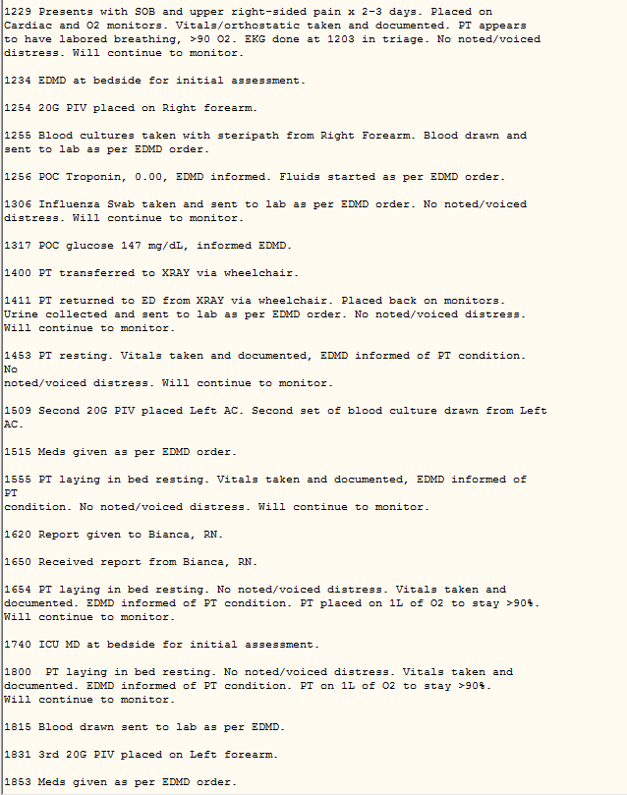
Sample Documentation

Slide 64
Q31 bldculdt and bldcultm
During specified time frame enter date/time blood culture drawn/collected.
Guidelines same as for Q30 bloodcul
If multiple blood cultures drawn or attempted, use earliest date/time.
Include: Blood culture drawn, blood culture to lab, blood culture received
Exclude: Blood sent to lab, lab here, labs drawn

Slide 65
Q32 bldculdel
Is there documentation supporting an acceptable delay in collecting a blood culture?
Only situations that demonstrate acceptable delay where blood culture was drawn after the Broad Spectrum or Other Antibiotic Administration Date and Time.
  Surgical patients who receive pre or post-op prophylactic antibiotic within 24 hours before severe sepsis identified
  Antibiotics started in hospital for infection within 24 hours before severe sepsis identified.
  Antibiotics started prior to hospital arrival within 24 hours before severe sepsis was identified
  A physician/APN/PA documented reason for delay, which makes it clear that waiting to start the antibiotic would be detrimental to the patient.
  OB patients given prophylactic antibiotics for ruptured membranes, group B strep, or prior to caesarean section.

Slide 66
Q33 lactate
During the timeframe from 6 hours prior to 6 hours after severe sepsis presentation, was an initial lactate level drawn (or collected)?
Timeframe for scoring is 6 hours prior to 3 hours after – collecting data up to 6 hours after for information
  If multiple lactate levels drawn within time frame, use the HIGHEST lactate level drawn PRIOR to Severe Sepsis Presentation Time.
  If multiple lactate levels drawn ONLY in the 3 hours after Severe Sepsis Presentation Time, use the Highest lactate level drawn
If no documentation lactate was drawn or collected, but there is supportive documentation, use earliest supportive documentation (e.g., lactate sent to lab, lactate received, lactate result).

Slide 67
Q33 lactate (cont.)
If within 24 hours of Severe Sepsis Presentation Time there is physician/APN/PA or nursing documentation lactate value is invalid, erroneous or questionable, disregard that value.
If lactate level drawn but no results in the record, choose Value “1.”
Include: lactate level collected, lactate level drawn, lactic acid drawn
Exclude: labs drawn

Slide 68
Q34 lactdt and lactm
Enter the date/time the initial lactate level was drawn.
Guidelines same as Q33 lactate
If more than one date/time of documentation for the Initial Lactate Level Collection, use the following order to determine which date/time to abstract.
  1. Laboratory documentation indicating date/time lactate was
  drawn.
  2. Non-narrative location indicating lactate was drawn with an
  associated date/time (e.g., sepsis flowsheet, checklist,
  screening).
  3. Narrative note indicating lactate is drawn with an associated
  date/time.

Slide 69
Q35 lacval
What initial lactate level result was documented in the record?
1. <= 2 mmol/L (less than or equal to 2 mmol/L)
2. > 2 and < 4.0 mmol/L (greater than 2 mmol/L and less than 4
mmol/L)
3. >= 4 mmol/L (4 mmol/L or greater)
99. Initial lactate result was not documented or unable to determine result
May be reported as mmol/L or mg/dL
Equivalents in D/D rules
If POC and lab results from the same sample, use the results recorded first.
If physician/APN/PA documents prior to or within 24 hours after initial lactate result indicating initial lactate value is due to a condition that is not an infection, or is due to a medication, select Value “1” (<= 2mmol/L).

Slide 70
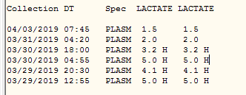
Q35 lacval - Sample Documentation
03/30/2019 0250 ED Clinician note “Severe sepsis, WBC 19 17…”
(6 hrs before = 3/29/2019 2050 to 6 hrs after = 3/30/2019 0850)

Slide 71
Q36 replact
During the timeframe from (computer display lacdt/lactm to sepresdt/seprestm +1 day) was a repeat lactate level drawn?
Next level drawn after initial if elevated (>2.0 mmol/L)
Must be in specified timeframe – if not select Value “2”
Other guidelines same as Q33 lactate
Include: lactate level collected, lactate level drawn, lactic acid drawn
Exclude: labs drawn

Slide 72
Q37 replactdt and replactm
During the specified timeframe, enter the earliest date/time the repeat lactate level was drawn (or collected).
Guidelines same as Q36 replact

Slide 73
Q38 hypotns
During the time frame from 6 hours prior to 6 hours after severe sepsis presentation is there documentation initial hypotension was present?
Criteria for determining Initial Hypotension:
Two hypotensive blood pressure readings at different times within the specified time frame.
  systolic blood pressures <90, or
  mean arterial pressures (MAP) <65, or
  a decrease in systolic blood pressure by >40 mm/Hg.
Physician/APN/PA documentation must be present
indicating a >40 mmHg decrease in SBP has occurred
and is related to infection or severe sepsis and not
other causes.

Slide 74
Q38 hypotns (cont.)
Definition of MAP in D/D rules. There are methods to calculate, but ONLY accept actual documentation of MAP <65.
Acceptable Hypotensive BPs (Examples in D/D rules)
Pre-hospital records considered part of medical record
Due to:
  Acute condition
  Acute on chronic condition
  Infection
Term documented instead of abnormal value
Conflicting documentation – hypotension normal AND possibly due to severe sepsis

Slide 75

Q39 hypotns
Not Acceptable Hypotensive BPs:
Obtained in the OR, interventional radiology, during active delivery, or procedural/conscious sedation
Documented from an orthostatic BP evaluation (tilt test).
Documented as normal for patient
Documented as due to non-infectious source/process

Slide 76
Q40 hypotnsdt and hypotnstm
Enter the date/time on which initial hypotension was present during the time frame from 6 hours prior to 6 hours after severe sepsis presentation.
Use earliest date/time of the second hypotensive BP documented in time period
If more than two hypotensive BPs in time period use the date/time of the second hypotensive BP
Use date/time documented for when hypotensive BP was taken or obtained if available. If not available, use recorded or documented date/time.

Slide 77
Q40 sepshk
Did a physician/APN/PA document presence of septic shock?
Include: Septic Shock, Severe Sepsis with Shock
Exclude: Bacteremia, Septicemia, Shock (not referenced as related to Severe Sepsis or Septic Shock)
Presence of Septic Shock may be identified based upon physician/APN/PA documentation OR clinical criteria.
Look first for physician/APN/PA documentation of Septic Shock and choose Value “1” if found.

Slide 78
Q40 sepshk
    In order to establish the presence of Septic Shock by clinical criteria, one of the following two criteria (1 or 2) must be met:
1. Severe Sepsis Present AND
Persistent Hypotension evidenced by:
    In the hour after the conclusion of the target ordered volume of Crystalloid Fluid Administration, two consecutive documented hypotensive blood pressure readings.
2. Severe Sepsis Present AND
Tissue hypoperfusion evidenced by
    Initial Lactate Level Result is >=4 mmol/L

Slide 79
Q40 sepshk
If Septic Shock presentation is more than six hours after Severe Sepsis Presentation Time, select Value “2”.
Do NOT use title or heading of order set, protocol, checklist, etc.
Documentation of septic shock within an order set, etc. may be used IF: recorded date and time is present and is earliest date and time recorded
Use pre-hospital records (EMS, SNF) if considered part of medical record

Slide 80
Q40 sepshk
Choose Value “2” if within 6 hours after septic shock documentation, physician/APN/PA notes indicate patient:
  is not septic
  does not have Sepsis, Severe Sepsis, Septic Shock
  Septic Shock is due to a viral, fungal or parasitic infection
Qualifiers – Table in D/D rules
  Positive = Yes
  Negative/both = No

Slide 81
Q41 sepshkdt and sepshktm
Enter the earliest date/time a physician/APN/PA documented presence of septic shock OR the earliest date/time on which the final criterion for septic shock was met
First determine if documentation of septic shock
Septic Shock identified by severe sepsis present and persistent hypotension (Septic Shock Present criteria 1):
  Use the later date/time of either severe sepsis presentation
  or persistent hypotension.
  For persistent hypotension, use the date/time of the last
  consecutive blood pressure reading that identifies the
  presence of persistent hypotension.

Slide 82
Q41 sepshkdt and sepshktm
Septic Shock identified by severe sepsis present and initial lactate >=4 (Septic Shock Present criteria 2)
  Use the later date/time of either severe sepsis
  presentation or the initial lactate level result.
  To determine the date/time of the Initial Lactate Level
  result for Septic Shock Present criteria, use the following
  sources in priority order.
1. Primary source: Lactate result date from lab

Slide 83
Q41 sepshkdt and sepshktm
  Supporting sources in priority order if primary source not available:
1. Date/time within a narrative note that is directly
associated with the lactate result
2. Date/time the lactate result is documented in a non-
narrative location (e.g., sepsis flowsheet)
3. Initial Lactate Level Collection Date/Time
4. Physician/APN/PA or nursing narrative note open
date/time

Slide 84
Q41 sepshkdt and sepshktm
Use earliest arrival date/time for ED patient OR earliest arrival date/time on floor/unit for direct admits with:
  Septic shock clinical criteria met in pre-hospital records
  Physician/APN/PA documentation of septic shock in pre-
  hospital records
  Physician/APN/PA documentation septic shock present on
  arrival
If only documentation of septic shock is POA, use earliest date/time of:
  Physician/APN/PA note
  Admit order
  Disposition to inpatient
  Arrival to floor/unit

Slide 85
Q41 sepshkdt and sepshktm
If septic shock is in a physician/APN/PA note without a specific date/time documented within the note or documented using the acronym POA, the following apply:
  If it is the only documentation of Septic Shock in the
  note, use the date/time the note was started or opened.
  If Septic Shock is documented multiple times within the
  same note, use the earliest specified date/time.

Slide 86
Q42 cntrasepshk
During the timeframe from 6 hours before septic shock time to 6 hours after septic shock date/time, is there physician/APN/PA or nursing documentation that the patient or authorized patient advocate refused either a blood draw, IV fluid administration, or vasopressor administration?
Guidelines same as Q22 cntrasevsep

Slide 87
Q43 cmopall2
During the timeframe from 6 hours before to 6 hours after septic shock time, is there physician/APN/PA documentation of comfort measures only or palliative care?
Guidelines same as Q23 cmopall

Slide 88
Q44 crystl
During the timeframe from […] were crystalloid fluids initiated?
Specified time frame is within 6 hours prior through 3 hours after either of the following trigger events. If both present the specified time frame is determined by the earliest trigger.
  Initial Hypotension Date and Time
  Septic Shock Presentation Date and Time
Include: Crystalloid fluids such as: 0.9% saline solution, 0.9% Sodium Chloride (0.9%NaCl) Solution, Isolyte, Lactated Ringers (LR or RL) solution, normal saline (NS), Normosol, PlasmaLyte
Exclude: Crystalloid solutions that are given to flush other medications or IV lines

Slide 89
Q44 crystl
Documentation of fluid initiation:
  Medical record documentation must be clear that crystalloid fluids were actually initiated/started (i.e., date/time of administration is noted).
  Do not use physician/APN/PA orders as equivalent to actual initiation of fluids as they are not specific to initiation.
Crystalloid fluid orders:
  Physician/APN/PA orders are required
  Must include type, volume, and rate or time over which fluids are to be given.
  Terms bolus, wide-open, or open are acceptable for a rate of infusion duration.
  If type, volume, rate or infusion duration is missing, do not use the order toward the target ordered volume.
  The target ordered volume may be single order or series of multiple orders.
  If crystalloid fluids are initiated via multiple physician/APN/PA orders, only abstract crystalloid fluids initiated within the specified time frame.

Slide 90
Q44 crystl
Exception for Prior to Arrival: Documentation of fluids administered prior to arrival (e.g., ambulance, nursing home) are acceptable if documentation contains type, volume, start time, and either a rate, duration, or end time of the fluid infusion. A physician/APN/PA order for fluids administered prior to arrival is not required.
Exception for Operating Room (OR): Crystalloid fluids administered in the OR by a physician/APN/PA are acceptable without an order if a fluid type, infusion start time, and infusion rate or infusion end time is documented.
Documentation patient/authorized patient advocate has refused IV fluid administration prior to or within 6 hours following presentation of septic shock - select Value “98”

Slide 91
Q45 crystldt and crystltm
Enter the earliest date/time on which crystalloid fluids were initiated.
Timeframe same as in Q44 crystl
If single order written for target ordered volume, use date/time the solution was started as an IV infusion.
If single order written for target ordered volume and infusion given over multiple infusions, use start date/time of the first fluid infusion.
If multiple orders written that total the target ordered volume, use start date/time of the crystalloid fluid infusion that completes the target ordered volume.
If a crystalloid infusion is running at a maintenance rate (125 mL/hour or less) and the rate is increased to administer the target ordered volume, use the date/time the infusion rate is increased.
Do not abstract order date/time or date/time of IV access.

Slide 92
Q46 weight
Enter the patient’s weight in kilograms (kg).
If weight documented in pounds, divide the value by 2.2, round to the nearest whole number and enter the weight as kilograms
To calculate the appropriate target ordered volume use the actual or estimated weight in the following priority order.
1. Weight documented in the crystalloid fluid order
2. Weight documented closest and prior to the order for
crystalloid fluids
3. Weight documented closest and after the order for
crystalloid fluids

Slide 93
Q47 crystlvol
Computer will calculate the target volume based on weight entered and enter in milliliters (mL)
Q48 targvol
During the timeframe from […] was the target ordered volume of crystalloid fluids (computer display crystlvol) completely infused?
Timeframe based on multiple factors
The target ordered volume must be ordered and initiated within the specified time frame if Initial Hypotension or Septic Shock is present. To choose Value “1,” the target ordered volume must be documented as completely infused.
(Go to D/D Rules in Word document)

Slide 94

Sample Documentation
87 x 30 = 2610 mL Target Volume

Slide 95


Sample Documentation

Slide 96
Q48 targvol
Crystalloid fluid volumes ordered that are equivalent to 30 mL/kg or within 10% less than 30 mL/kg are considered the target ordered volume.
Example in D/D rules.
If the total volume of crystalloid fluids ordered is less than the target ordered volume, select Value “2.”
If there is documentation the infusion was stopped prior to reaching the target ordered volume, select Value “2.”

Slide 97
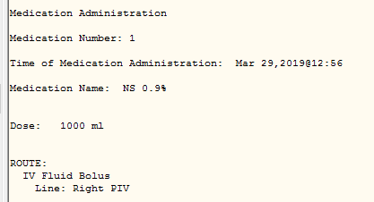
Sample Documentation

Slide 98
Q49 crystlend
Enter the earliest documented time the target ordered volume of crystalloid fluids was completed.
Review all data sources to determine the time the target ordered volume of crystalloid fluids was completed. Enter the exact time.

Slide 99
Q49 crystlend (following guidelines from pershypo)
If the completion time of the target ordered volume is NOT documented in the medical record use the following criteria to determine the conclusion time
  If the order includes a time frame over which to infuse the crystalloid fluid, identify the time the fluids are started and add to that the duration identified in the order. This will represent the conclusion of crystalloid fluids.
  Example: An order for 1500 mL over 1 hour and the infusion
  is started at 10:00. Add 1 hour to the start time to determine
  infusion end time of 11:00.

Slide 100
Q49 crystlend (Example)
Start time 14:26 – infuse over 2 hours
End time 16:26

Slide 101
Q49 crystlend (Example)
  If the order includes a rate at which to infuse the crystalloid fluids, the end time can be calculated based on the volume, the rate and the start time. Example: An order for 1500 mL at 1000 mL/hour and the infusion is started at 10:00. The time over which 1500 mL is infused is the volume divided by the rate. 1500 mL divided by 1000 mL/hour is 1.5 hours. Add 1.5 hours to the start time to determine infusion conclusion time of 11:30.

Slide 102
Q50 pershypo
During the time frame from time fluids are completed to 1 hour after fluids completed is there physician/APN/PA documentation that persistent hypotension or new onset of hypotension was present?
1. Yes
2. No
3. No, the patient was not assessed for persistent hypotension or new onset of hypotension within one hour after the conclusion of crystalloid fluid administration at the target ordered volume, or unable to determine
4. Not applicable - Crystalloid fluids were administered but at a volume less than the target ordered volume

Slide 103
Q50 pershypo
The criteria for determining persistent hypotension or new onset of hypotension are (same as for Q38 hypotns except different timeframe):
  In the one hour following conclusion of administration of the target ordered volume of crystalloid fluids, two consecutive documented blood pressure readings of either:
∗ systolic blood pressure <90, or
∗ mean arterial pressure (MAP) <65 or
∗ a decrease in systolic blood pressure by >40mm/Hg
Physician/APN/PA documentation must be present in
the medical record indicating a >40 mmHg decrease in
SBP has occurred and is related to infection, severe
sepsis or septic shock and not other causes.

Slide 104
Q50 pershypo
Hypotensive BPs within the hour acceptable to use (Examples in D/D rules)
Due to:
  Acute condition
  Acute on chronic condition
  Infection
Term documented instead of abnormal value
Conflicting documentation – hypotension normal or chronic AND possibly due to severe sepsis/septic shock
Persistent hypotension is unable to be determined but a vasopressor was administered

Slide 105
Q50 pershypo
Hypotensive BPs within the hour NOT acceptable to use
Obtained within OR, interventional radiology, during active delivery, or procedural/conscious sedation
Documented from an orthostatic BP evaluation (tilt test)
Documented as normal for patient due to chronic condition
Documented as due to non-infectious source/process
Persistent more that six hours after septic shock time

Slide 106
Q51 vasoprs
During the timeframe from septic shock time to 6 hours after, is there documentation an intravenous (IV) or intraosseous (IO) vasopressor was administered?
Only Acceptable Vasopressors given via the IV or IO route: (Table in D/D Rules)
Only abstract from documentation that demonstrates actual administration of the vasopressor.
(Go to Instrument)

Slide 107
Q52 vasoprsdt and vasoprstm
During the timeframe from septic shock time to 6 hours after, enter the date/time on which an IV or IO vasopressor was administered.
Guidelines follow Q51 vasoprs guidelines
If a vasopressor was infusing at the date/time of presentation of septic shock, and multiple doses were subsequently given, abstract the date/time the vasopressor that was infusing at the time of presentation of septic shock was initiated.
(See Example in D/D rules)

Slide 108
Q54 rptvolst
During the timeframe from initial time of fluid administration to 6 hours after septic shock presentation time, is there documentation of a repeat volume status and tissue perfusion assessment?
A repeat volume status and tissue perfusion assessment may consist of any one of the following three:
  1. Physician/APN/PA documentation indicating or attesting to performing or completing a physical examination, perfusion (re-perfusion) assessment, sepsis (severe sepsis or septic shock) focused exam, or systems review. (Examples in D/D rules)

Slide 109
Q54 rptvolst
  2. Physician/APN/PA documentation indicating or attesting to performing or completing a review of at least five of the following eight parameters
    Arterial O₂ saturation
    Capillary Refill
    Cardiopulmonary assessment (See D/D rules)
    Peripheral pulses
    Shock Index (SI)
    Skin Color or Condition
    Urine Output
    Vital Signs

Slide 110
Q54 rptvolst
  3. Documentation demonstrating one of the following was measured or performed.
    CVP
    ScvO₂
    Echocardiogram
    Fluid Challenge or Passive Leg Raise
If No documentation found of repeat volume status and tissue perfusion assessments, choose Value “2” for Q54 rptvolst

Slide 111
Q55 rptvolstdt and rptvolsttm
During the timeframe from initial time of fluid administration to 6 hours after septic shock presentation time, enter the date/time on which a repeat volume status and tissue perfusion assessment was documented by a physician/APN/PA.
Physician/APN/PA documentation must occur or reflect the assessment was performed between Crystalloid Fluid Administration Date/Time and six hours after Septic Shock Presentation Date/Time.
If multiple repeat volume status and tissue perfusion assessments performed, abstract the date/time of the earliest assessment documented within the appropriate time window.

Slide 112

QUESTIONS??
Abstraction to be completed by 7/29/20
Email shmiller@qualityinsights.org
asites@qualityinsights.org
Thank you!

